Slide 1
Rita Insight July 11th
Tree-based Algorithms

Slide 2
Decision Trees
Each node checks one feature x_{i} :
Go left if x_{i} < threshold
Go right if x_{i} ≥ threshold
Strength:
It’s a nonlinear classifier
Better interpretability
Can naturally handle categorical features
Computation:
Training: slow
Prediction: fast (h operations)
Notes:
(h: depth of the tree) h<=15

Slide 3
Root Node: It represents entire population or sample and this further gets divided into two or more homogeneous sets.
Splitting: It is a process of dividing a node into two or more sub-nodes.
Decision Node: When a sub-node splits into further sub-nodes, then it is called decision node.
Leaf/ Terminal Node: Nodes do not split is called Leaf or Terminal node.
Pruning: When we remove sub-nodes of a decision node, this process is called pruning. You can say opposite process of splitting.
6. Branch / Sub-Tree: A sub section of entire tree is called branch or sub-tree.
7. Parent and Child Node: A node, which is divided into sub-nodes is called parent node of sub-nodes where as sub-nodes are the child of parent node.

Slide 4
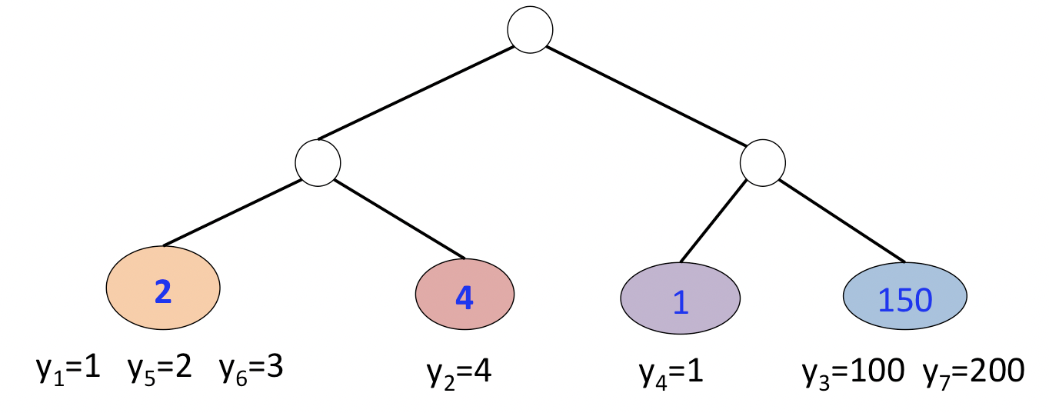
Regression Trees vs Classification Trees
Dependent variable
continuous
categorical
Output
mean
mode
Decision criteria of splits
MSE/MAE
Information gain/ Gini
Notes:
Output of training data is the mean response of observation falling in that region.

Slide 5
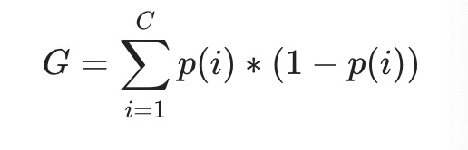
Gini/Gini Impurity
Steps to Calculate Gini for a split:
Calculate Gini for sub-nodes, using formula sum of square of probability for success and failure (p²+q²).
Calculate Gini for split using weighted Gini score of each node of that split
Gini Impurity = 1-Weighted Gini
Notes:
It performs only Binary splits
Higher the value of Gini higher the homogeneity.
CART (Classification and Regression Tree) uses Gini method to create binary splits.
Split on Gender:
Calculate, Gini for sub-node Female = (0.2)*(0.2)+(0.8)*(0.8)=0.68
Gini for sub-node Male = (0.65)*(0.65)+(0.35)*(0.35)=0.55
Calculate weighted Gini for Split Gender = (10/30)*0.68+(20/30)*0.55 = 0.59

Slide 6
Information Gain/Entropy
Entropy is the measures of impurity, disorder or uncertainty in a bunch of examples.
Information gain (IG) measures how much “information” a feature gives us about the class.

Slide 7
Information Gain/Entropy
Steps to Calculate IG for a split:
Calculate entropy of parent node
Calculate entropy of each individual node of split and calculate weighted average of all sub-nodes available in split.
IG = result of step 1 – result of step 2
Notes:
Entropy for parent node = -(15/30) log2 (15/30) – (15/30) log2 (15/30) = 1. Here 1 shows that it is a impure node.
Entropy for Female node = -(2/10) log2 (2/10) – (8/10) log2 (8/10) = 0.72 and for male node, -(13/20) log2 (13/20) – (7/20) log2 (7/20) = 0.93
Entropy for split Gender = Weighted entropy of sub-nodes = (10/30)*0.72 + (20/30)*0.93 = 0.86
information gain from entropy as 1- Entropy.

Slide 8
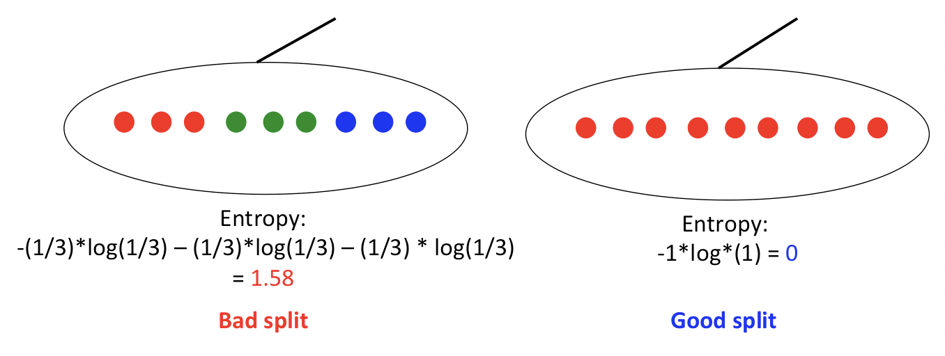
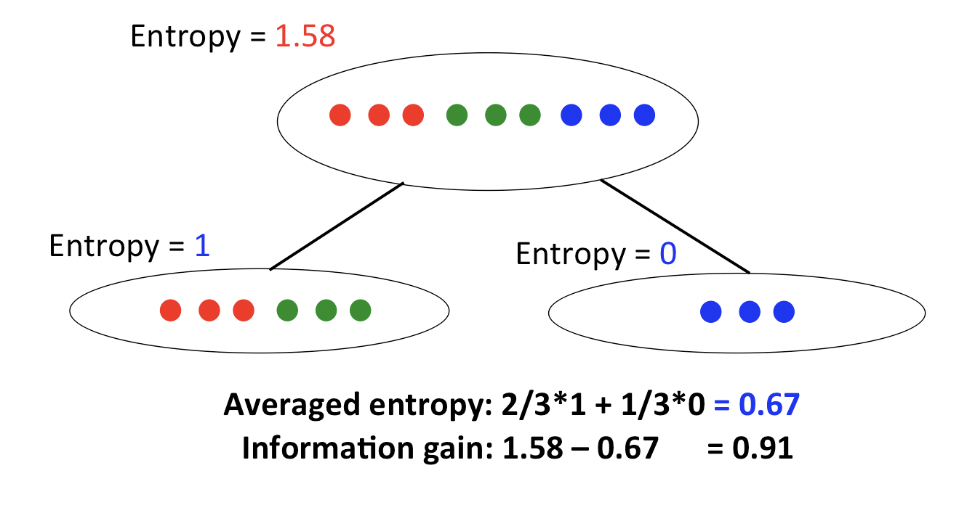
Notes:
Given the current note, how to find the best split?
For all the features and all the threshold
Compute the information gain after the split Choose the best one (maximal information gain)

Slide 9
Over-fitting
1.Setting constraints on tree size 2. Tree pruning
Notes:
Overfitting is one of the key challenges faced while modeling decision trees. If there is no limit set of a decision tree, it will give you 100% accuracy on training set because in the worse case it will end up making 1 leaf for each observation.
Maximum features to consider for split
The number of features to consider while searching for a best split. These will be randomly selected.
As a thumb-rule, square root of the total number of features works great but we should check upto 30-40% of the total number of features.
Higher values can lead to over-fitting but depends on case to case.

Slide 10
Ensemble Methods in Tree Based Modeling
The literary meaning of word ‘ensemble’ is group.
Ensemble methods involve group of predictive models to achieve a better accuracy and model stability.
Ensemble learning is one way to execute this trade off of bias-variance errors.
Notes:
Normally, as you increase the complexity of your model, you will see a reduction in prediction error due to lower bias in the model. As you continue to make your model more complex, you end up over-fitting your model and your model will start suffering from high variance.

Slide 11
Trade Off of Bias-Variance
Bias is the difference between the average prediction of our model and the correct value which we are trying to predict.
Variance is the variability of model prediction for a given data point or a value which tells us spread of our data.
Notes:
Model with high bias pays very little attention to the training data and oversimplifies the model.
Model with high variance pays a lot of attention to training data and does not generalize on the data which it hasn’t seen before.

Slide 12
Bagging/Bootstrap Aggregation
The key to bagging is that trees are repeatedly fit to bootstrapped subsets of the observations.
Sampling is done with replacement on the original data.
Notes:
Commonly used ensemble methods include: Bagging, Boosting and Stacking.
We’ll talk about Bagging and Boosting.
The new data sets can have a fraction of the columns as well as rows, which are generally hyper-parameters in a bagging model
Taking row and column fractions less than 1 helps in making robust models, less prone to overfitting
The predictions of all the classifiers are combined using a mean, median or mode value depending on the problem at hand.
Random forest is one of them and we’ll discuss it next.

Slide 13
Random forests
Random forests provide an improvement over bagged trees by way of a small tweak that decorrelates the trees.
Notes:
A large number of relatively uncorrelated models (trees) operating as a committee will outperform any of the individual constituent models.

Slide 14
Random forests
sklearn.ensemble.RandomForestClassifier
n_estimators:
The number of trees in the forest.
criterion:
default=”gini” for classifier
max_features:
default=”auto”, sqrt(n_features)
max_depth:
The maximum depth of the tree.
bootstrap :
default=True, Whether bootstrap samples are used when building trees.
min_samples_split: The minimum number of samples required to split an internal node.
min_samples_leaf : minimum number of samples required to be at a leaf node.

Slide 15
Feature Importance
When training a tree we can compute how much each feature contributes to decreasing the weighted impurity/variance.
Averaging the decrease over trees = The power of the feature
feature_importances_ : array of shape = [n_features]
Return the feature importances (the higher, the more important the feature).

Slide 16
Boosting
The term ‘Boosting’ refers to a family of algorithms which converts weak learner to strong learners.
Step 1: The base learner takes all the observations and assign equal weight or attention to each observation.
Step 2: If there is any prediction error caused by first base learning algorithm, then we pay higher attention to observations having prediction error. Then, we apply the next base learning algorithm.
Step 3: Iterate Step 2 till the limit of base learning algorithm is reached or higher accuracy is achieved.
Trees are grown sequentially: each tree is grown using information from previously grown trees.

Slide 18
Boosting Algorithm: AdaBoost
+
+
=
Assigned equal weights to each data point and applied a decision stump to classify them as + (plus) or – (minus).
The size of three incorrectly predicted + (plus) is bigger. Assign higher weight to three + (plus) and apply another decision stump.
Again, we will assign higher weight to three – (minus) and apply another decision stump.
Combined three to form a strong prediction having complex rule as compared to individual weak learner.
n_estimators: It controls the number of weak learners.
learning_rate: Controls the contribution of weak learners in the final combination.
base_estimators: It helps to specify different ML algorithm.
Notes:
AdaBoost (Adaptive Boosting) the first successful boosting algorithm

Slide 19
Boosting Algorithm: Gradient Boosting
In Adaboost, “shortcomings” are identified by high-weight data points.
In Gradient Boosting, “shortcomings” are identified by gradients.
Gradient Boosting = Gradient Descent + Boosting
Gradient boosting involves three elements:
A loss function to be optimized. [loss: loss function to be optimized.]
A weak learner to make predictions.
An additive model to add weak learners to minimize the loss function.
Notes:
Formulate Adaboost as gradient descent with a special loss function[Breiman et al., 1998, Breiman, 1999]
Generalize Adaboost to Gradient Boosting in order to handle a variety of loss functions [Friedman et al., 2000, Friedman, 2001]
The loss function used depends on the type of problem being solved.
Decision trees are used as the weak learner in gradient boosting.
Trees are added one at a time, and existing trees in the model are not changed.
A gradient descent procedure is used to minimize the loss when adding trees.

